Slide 1
Overview of Core Design Patterns
Crystal Tenn
Crystal.Tenn@microsoft.com

Slide 2
The Software Development Pyramid
Completeness
The design must cover as many important situations as is practical.
Consistency
The design should be consistent.
Simplicity
The design must be simple, both in implementation and interface. The primary job of an Architect is to take the complex and make it simple and easy to use/maintain. Simplicity is the single most important design criteria outside of correctness.
Correctness
The design must be correct in all observable aspects. The “correctness” is verified by testing against defined requirements.

Slide 3
Object Oriented Design Philosophy
Writing “SOLID” Code
Principles articulated circa 2000 by “Uncle Bob” (Robert C. Martin)
Michael Feathers is credited with the acronym
Each Principle Helps with OOD
S – Single Responsibility Principle
O – Open/Closed Principle
L – Liskov Substitution Principle
I – Interface Segregation Principle
D – Dependency Inversion Principle
DRY and YAGNI
Don’t Repeat Yourself. Duplicity in code is a sure way to fail.
You Ain’t Gonna Need It. Don’t borrow problems from the future. Solve today’s issues only.
Notes:
S=Single Responsibility
(a class should have only a single responsibility. There should never be more than one reason for a class to change.
This means that you should design your classes in such a way that each class should have a single purpose. )
O=Open/Closed
(software entities (classes, modules, functions, etc.) should be open for extension but closed for modification.
The "closed" part of the rule states that once a module has been developed and tested, the code should only be changed to correct bugs.
The "open" part says that you should be able to extend existing code in order to introduce new functionality.
L=Liskov’s principle
(objects in a program should be replaceable with instances of their subtypes without altering the correctness of that program)
I=Interface Segregation
(Clients should not be forced to depend upon interfaces that they don’t use.
This means the number of members in the interface that is visible to the dependent class should be minimized.
Mmany client-specific interfaces are better than one general-purpose interface)
D=Dependency Inversion Principle means that you should be using interfaces to abstract all of the critical dependencies of a given class.

Slide 4
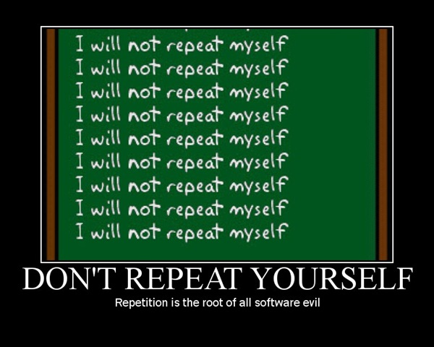
DRY
Stands for Don’t Repeat Yourself
DRY aims to reducing repetition of information of all
Kinds especially in multi-tiered architectures.
“Every piece of knowledge must have a single, unambiguous, authoritative representation within a system.”
AKA “The Single Source of Truth” philosophy

Slide 5
DRY
Inadvertent Duplication
Developers don't realize that they are duplicating
functionality.
“Cutting-Corners” Duplication
Developers are pressured and duplication, it saves time.
Inter-developer Duplication
Multiple people on a team (or on different teams) duplicate a piece of information.
Beware: Duplication can be subtle…
Identical code in different locations
Identical functionality in different locations
Either can lead to a maintenance nightmare!

Slide 6
DRY
Inadvertent Duplication
Developers don't realize that they are duplicating
functionality.
“Cutting-Corners” Duplication
Developers are pressured and duplication, it saves time.
Inter-developer Duplication
Multiple people on a team (or on different teams) duplicate a piece of information.
Beware: Duplication can be subtle…
Identical code in different locations
Identical functionality in different locations
Either can lead to a maintenance nightmare!

Slide 7
YAGNI
"You aren't gonna need it" is a principle that states a programmer should not add functionality until deemed necessary.
XP co-founder Ron Jeffries has written: "Always implement things when you actually need them, never when you just foresee that you need them.“
It may not be obvious why this is an issue until…

Slide 8
YAGNI
The time spent is taken from adding, testing or improving the currently necessary functionality.
The new features must be debugged, documented, and supported.
Microsoft must translate everything into eight languages for initial release
New features impose constraints on what can be done in the future
Until it’s actually needed, it is difficult to fully define what a new feature should do and test it.
This leads to code bloat and adds complexity that’s not required.
Plus, the feature may not be known to programmers who could make use of it.
Adding the new feature may suggest other new features. If these new features are implemented as well, this could result in a snowball effect towards feature creep.

Slide 9
KISS
Keep it simple stupid.
“Simplicity is the ultimate sophistication” – Leonardo da Vinci
Kelly Johnson (credited with the acronym) gave his team of design engineers a handful of tools, with the challenge that the jet aircraft they were designing must be repairable by an average mechanic, in the field, under combat conditions with only these tools.
‘Stupid' refers to the relationship between the way things break and the sophistication available to fix them

Slide 10
Let’s talk about the Gang of Four patterns
Notes:
Benefits of containers include: Density and agility, enabling agile application development and deployment
Don’t mistake Hyper-V container with a VM – containers are much more agile (deploy with a flip of the bits, etc.)

Slide 11
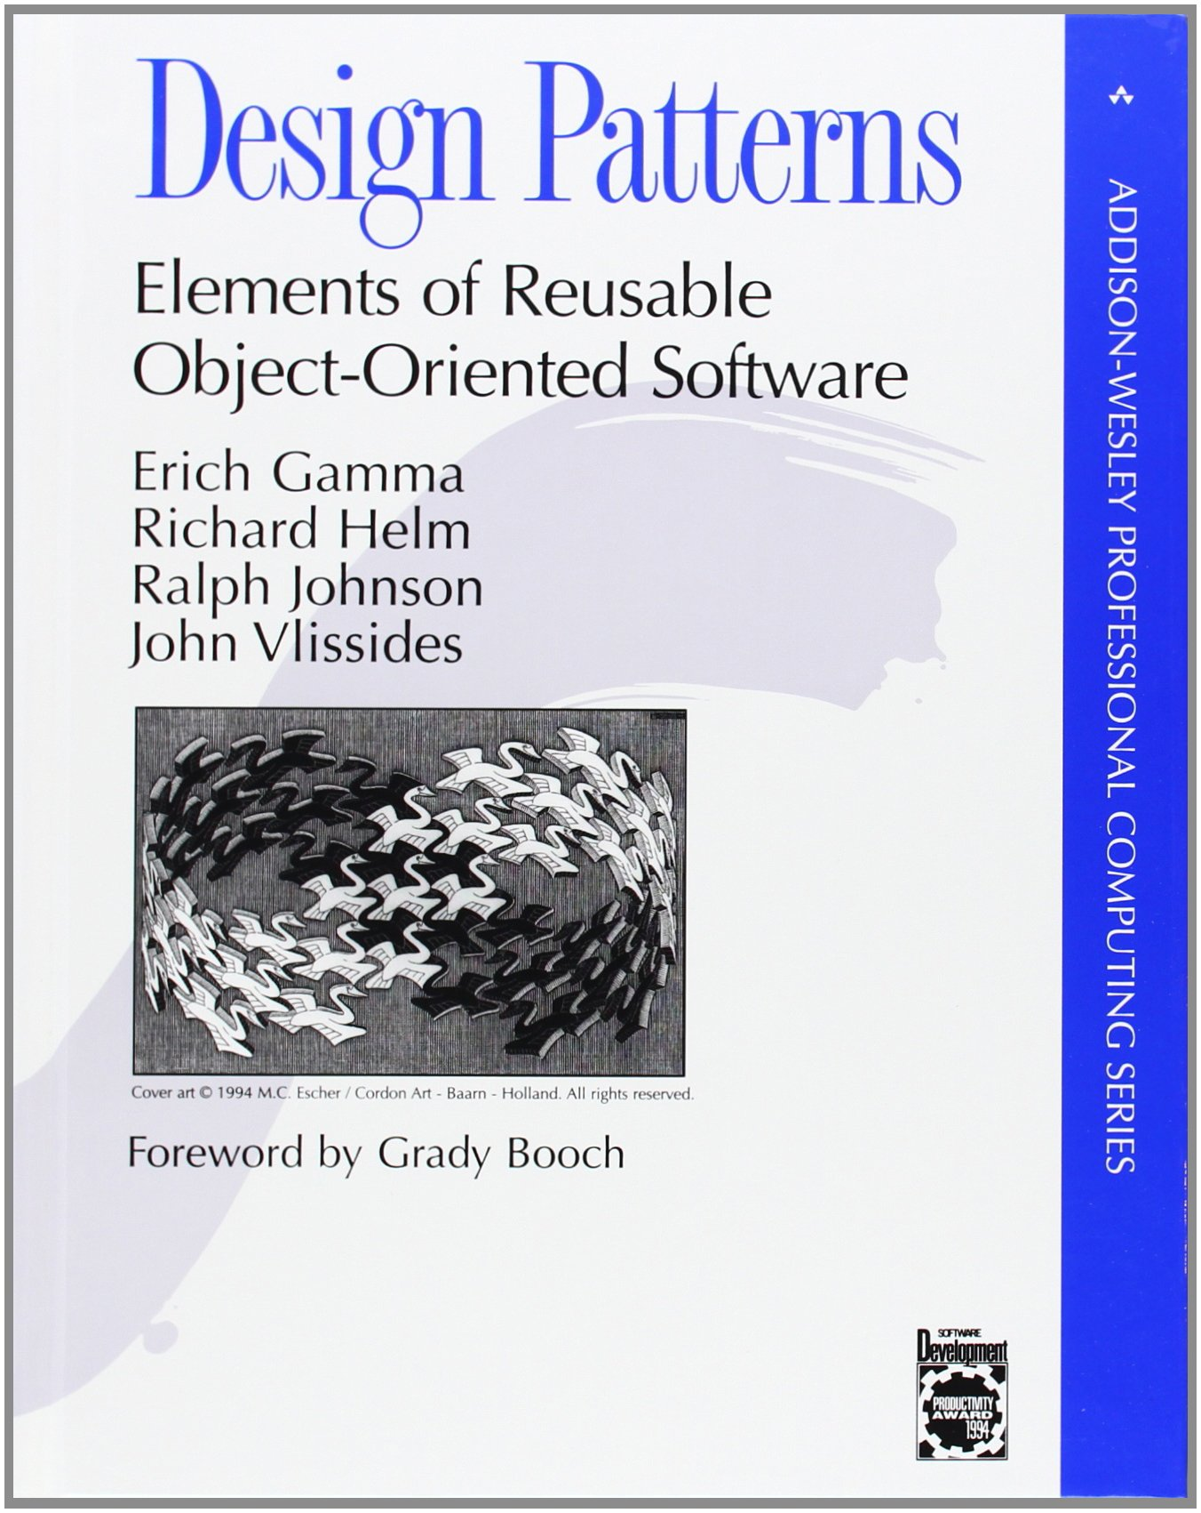
GoF patterns
There are 23 of them (there are a lot of them and they are difficult to remember).
They fit into 3 categories
The 4 authors of the book “Design Patterns: Elements of Reusable Object-Oriented Software” are often referred to as the Gang of Four.

Slide 12
Rubrics Used for Three Core Categories
Creational
Patterns create objects for you, rather than have you instantiate them directly. This gives you flexibility in deciding which objects need to be created in any given case and also enabled an interface-based-design.
Structural
Patterns concern class and object composition. The use inheritance to compose interfaces and define ways to compose objects to obtain new functionality.
Behavioral
Patterns allow objects to enable complex and adaptable responses, often through communication between objects.

Slide 13
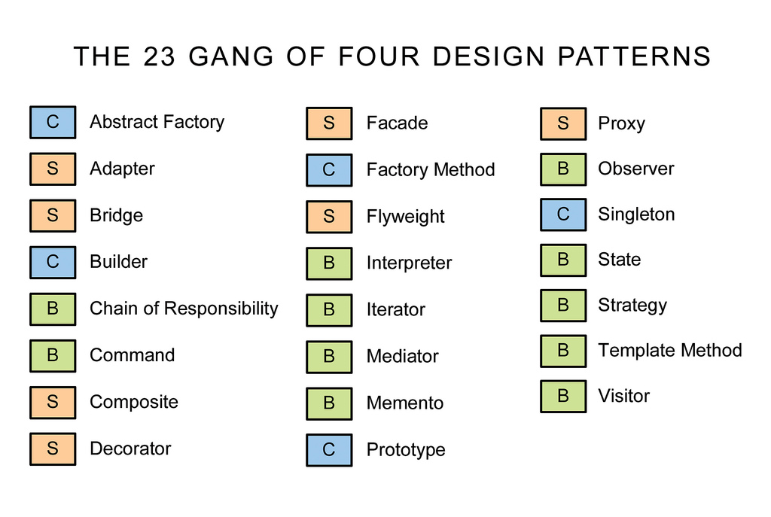

Slide 14
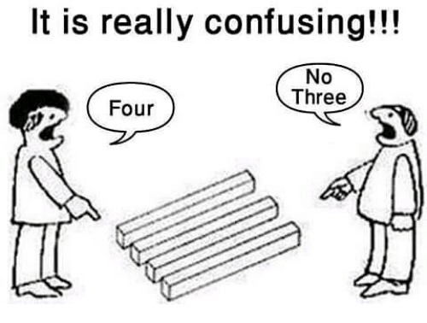
GoF patterns
Most commonly used: Abstract Factory, Factory, Façade, Iterator, Observer,
Sometimes used: Singleton, Adapter, Composite, Proxy, Command, Strategy
**hint, remember all of these above!!
Least commonly used: Flyweight, Interpreter, Memento, Visitor.
**hint.. Small chance of seeing these.

Slide 15
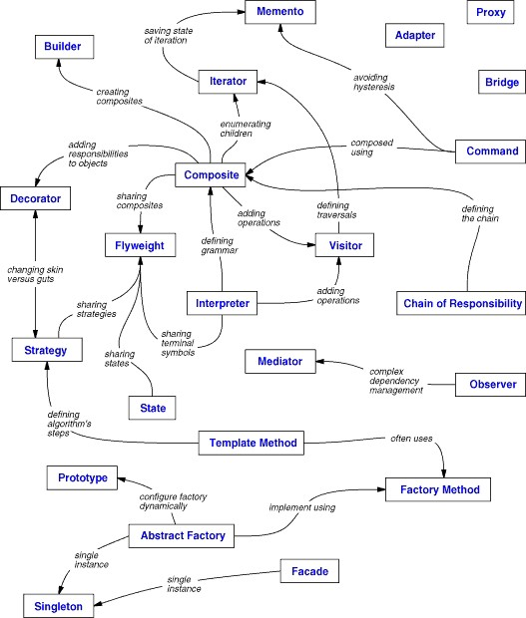

Slide 16
Lab
01 Lab – Core Design Patterns.docx
01 Core Design Patterns [begin]
Notes:
End 37 mins

Slide 17
Thank you!

